Slide 1
“SELF” POL
Richard Barclay
Da vinci Design High School
September 1, 2017

Slide 2
Name of your Personality Test Character
Four letter results: INTJ
I – Introvert
N – Intuitive
T – Thinker
J – Judger
Two of your strengths
1)
2)
Two of your weaknesses
1)
2)

Slide 3
“SELF” Research
Current GPA: ___________
Weighted GPA: ____________
Freshman Year Grades: (1st/2nd)
English C/A
Math A/I
Science B/B
Foreign Language C/A
Art I/I
Sophomore Year Grades: (1st/2nd)
English B/B
History A/A
Math B/I
Science C/C
Foreign Language A/C
Art I/A

Slide 4
Top Career Choice
History Teacher
List College Majors for your top career
  1) History
  2) Political Science
  3) American Studies
National Salary: $100,000/year

Slide 5

University of California, Los Angeles
Location: Los Angeles, California
Student population: 1 million
Average GPA: 4.75
Admission Rate: 0.01%
Average ACT Score: 36
Average SAT Score: 1600
Tuition Costs: $36,000/year
Room and Board: $12,000/year

Slide 6
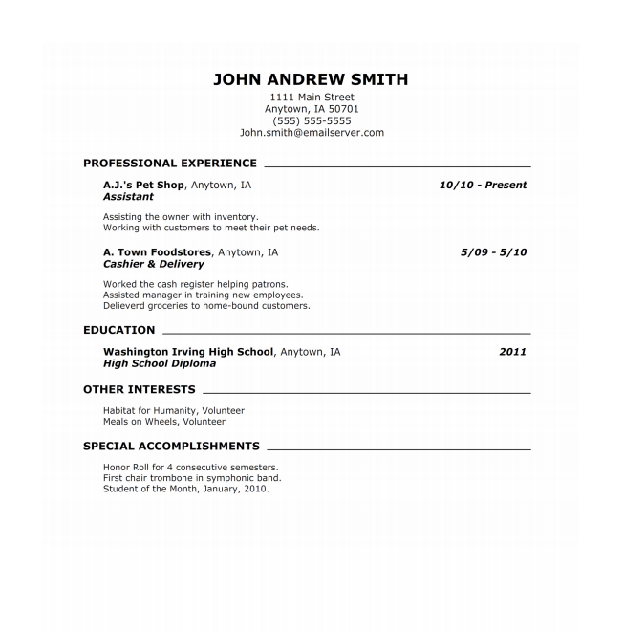
List your college attractiveness score here:
GPA Score: ______
Qualifications : ______
Experience: _____
Activities: ______
Awards: _____
Total Points: _______ (Your college attractiveness score out of 100)

Slide 7
Action Plan
Goals for Junior Year based on your “Self” Research

